Slide 1
同步电路设计
之
Verilog设计实例

Slide 2
主要内容
Arithmetic and Logic Unit(ALU)
Finite State Machine
Misc. Circuit

Slide 3
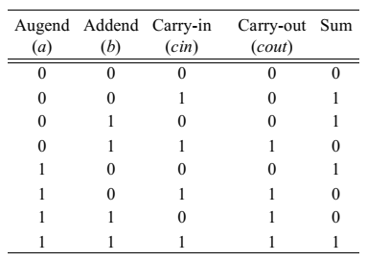
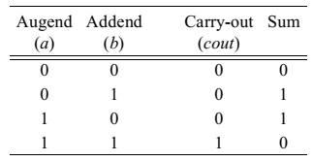
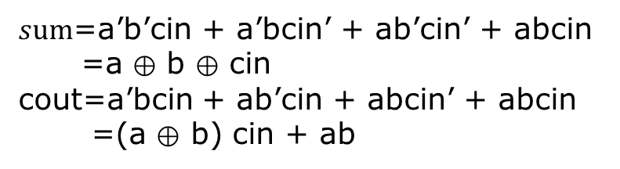
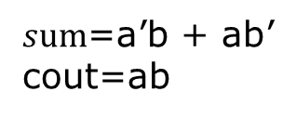
ALU之加法器
1-bit全加器真值表
1-bit半加器真值表
$sum$=a’b + ab’
cout=ab
$sum$=a’b’cin + a’bcin’ + ab’cin’ + abcin
=a ⊕ b ⊕ cin
cout=a’bcin + ab’cin + abcin’ + abcin
=(a ⊕ b) cin + ab

Slide 4
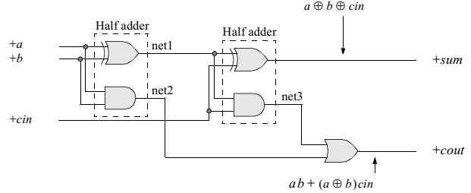
ALU之加法器(cont)
1-bit全加器
电路实现
module full_adder(a, b, cin, sum, cout);
//define inputs and outputs
input a, b, cin;
output sum, cout;
//design the full adder
//design the sum
xor inst1 (net1, a, b);
and inst2 (net2, a, b);
xor inst3 (sum, net1, cin);
//define the carry-out
and inst4 (net3, net1, cin);
or inst5 (cout, net3, net2);
endmodule
课堂练习：
1) 用Verilog实现half_adder
2) 用half_adder实现full_adder

Slide 5
ALU之加法器(cont)
4-bit全加器
电路实现
module adder4(a, b, cin, sum, cout);
//define inputs and outputs
input [3:0] a, b;
input cin;
output[3:0] sum;
output cout;
assign {cout, sum} = a + b + cin;
endmodule
module tb_adder4;
reg [3:0] a, b;
reg cin;
wire[3:0] sum;
wire cout;
integer ii;
adder4 dut(a, b, cin, sum, cout);
initial begin
for(ii=0; ii<512; ii=ii+1) begin
{a,b,cin} = ii;
#10 $display(“%b,%b,%b,%b,%b”,a,b,cin,sum,cout);
end
end
endmodule

Slide 6
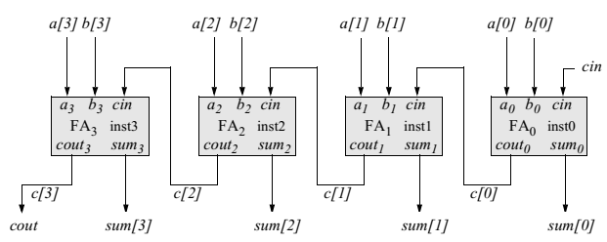
ALU之加法器(cont)
4-bit全加器: Ripple-carry实现
课堂练习：
用Verilog实现上述电路中的加法器
为其建立testbench，并验证该加法器的结果是否正确

Slide 7
ALU之加法器(cont)
//structural for four-bit ripple-carry adder
module adder4_ripple_carry (a, b, cin, sum, cout);
//define inputs and outputs
input [3:0] a, b;
input cin;
output [3:0] sum;
output cout;
//define internal nets
wire [3:0] c;
//define output
assign cout = c[3];
//design the ripple-carry adder
//instantiating the full adders
full_adder inst0 (a[0], b[0], cin , sum[0], c[0]);
full_adder inst1 (a[1], b[1], c[0], sum[1], c[1]);
full_adder inst2 (a[2], b[2], c[1], sum[2], c[2]);
full_adder inst3 (a[3], b[3], c[2], sum[3], c[3]);
endmodule
扩展思考1：carry-ahead adder
扩展思考2：定点数减法如何实现？

Slide 8
ALU之乘法器(cont)
//structural for four-bit ripple-carry adder
module adder4_ripple_carry (a, b, cin, sum, cout);
//define inputs and outputs
input [3:0] a, b;
input cin;
output [3:0] sum;
output cout;
//define internal nets
wire [3:0] c;
//define output
assign cout = c[3];
//design the ripple-carry adder
//instantiating the full adders
full_adder inst0 (a[0], b[0], cin , sum[0], c[0]);
full_adder inst1 (a[1], b[1], c[0], sum[1], c[1]);
full_adder inst2 (a[2], b[2], c[1], sum[2], c[2]);
full_adder inst3 (a[3], b[3], c[2], sum[3], c[3]);
endmodule
扩展思考1：carry-ahead adder
扩展思考2：定点数减法如何实现？

Slide 9
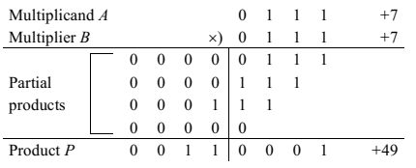
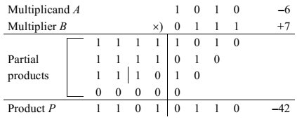
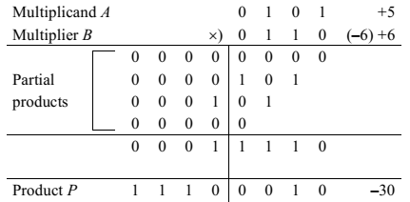
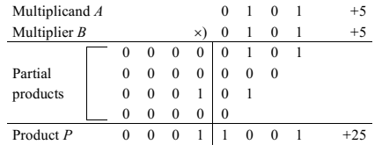
ALU之乘法器
定点乘法：behavior model
1）正数 * 正数 = 正数
2）负数 * 正数 = 负数
3）正数 * 负数 = 负数
对负数转为2进制补码进行乘法计算，最后结果再进行补码转换
4）负数 * 负数 =正数
对两个负数均转为补码进行运算，结果无需再转换
例:(-5) * (-5)

Slide 10
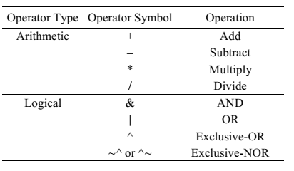
ALU之乘法器(cont)
利用Verilog乘法运算符直接计算
//dataflow for 4-bit multiplier
module mul_4bits_assign (mpcnd, mplyr, prod);
//define inputs and outputs
input [3:0] mpcnd, mplyr;
output [7:0] prod;
//calculate the product
assign prod = mpcnd * mplyr;
endmodule

Slide 11
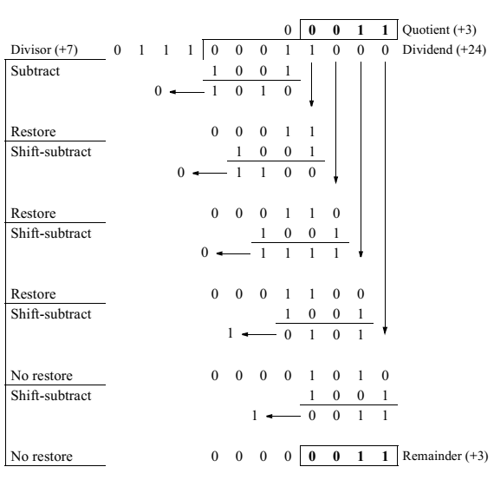
ALU之除法器
定点除法：Dividend / Divisor = Quotient
例：restoring division algorithm

Slide 12
ALU之除法器(cont)
//mixed-design for restoring division
module div_restoring (
input [7:0] a，
input [3:0] b，
input start，
output [7:0] rslt，
);
//define internal net
wire [3:0] b_neg;
//define internal registers
reg [7:0] rslt;
reg [3:0] count;
assign b_neg = ~b + 1;
//continue on the right side
//execute the behavioral statements always @ (posedge start) begin
rslt = a;
count = 4'b0100;
if ((a!=0) && (b!=0))
while (count) begin
rslt = rslt << 1;
rslt = {(rslt[7:4] + b_neg), rslt[3:0]};
if (rslt[7] == 1) begin
rslt = {(rslt[7:4] + b), rslt[3:1], 1'b0};
count = count - 1;
end
else begin
rslt = {rslt[7:1], 1'b1};
count = count - 1;
end
end
end
endmodule
注意：这是一个行为模型！！

Slide 13
ALU(Arithmetic and Logic Unit)
例：4-bit ALU，支持加法，减法，乘法，除法，逻辑或，逻辑反，逻辑异或，逻辑同或运算
Module alu_8(
input [3:0] a,b,
input [2:0] opcode,
Output reg [7:0] rslt);
localparam add_op=3’d0,sub_op=3’d1,mul_op=3’d2, div_op=3’d3,or_op=3’d4,inv_op=3’d5,xor_op=3’d6,xnor_op=3’d7;
always@( * ) begin
case(opcode)
add_op: rslt = a + b;
sub_op: rslt = a - b;
mul_op: rslt = a * b;
div_op : rslt = a / b;
or_op : rslt = a | b;
inv_op : rslt = ~a;
xor_op : rslt = a ^ b;
xnor_op:rslt = ~(a ^ b);
endcase
end
endmodule
注意：这是一个行为模型！！

Slide 14
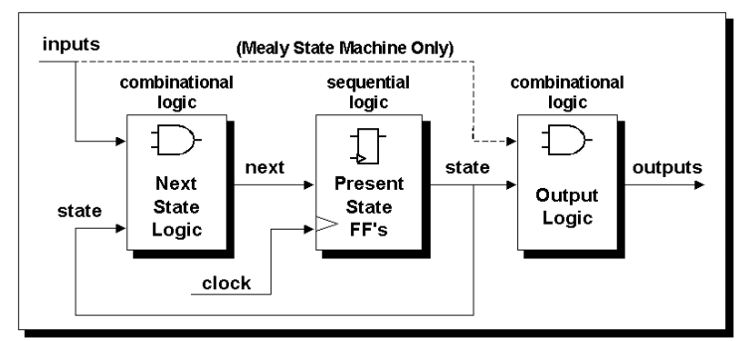
Finite State Machine(FSM)
Mealy and Moore FSMs
  A Moore FSM is a state machine where the outputs are only a function of the present state.
  A Mealy FSM is a state machine where one or more of the outputs is a function of the present state and one or more of the inputs.

Slide 15
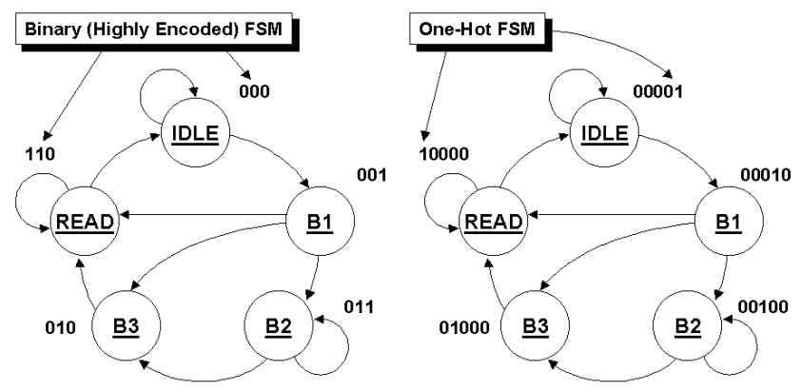
FSM state encoding
Binary encoded or one-hot encoded?
  Binary encoded uses less flip-flops.
  One-hot encoded runs faster.

Slide 16
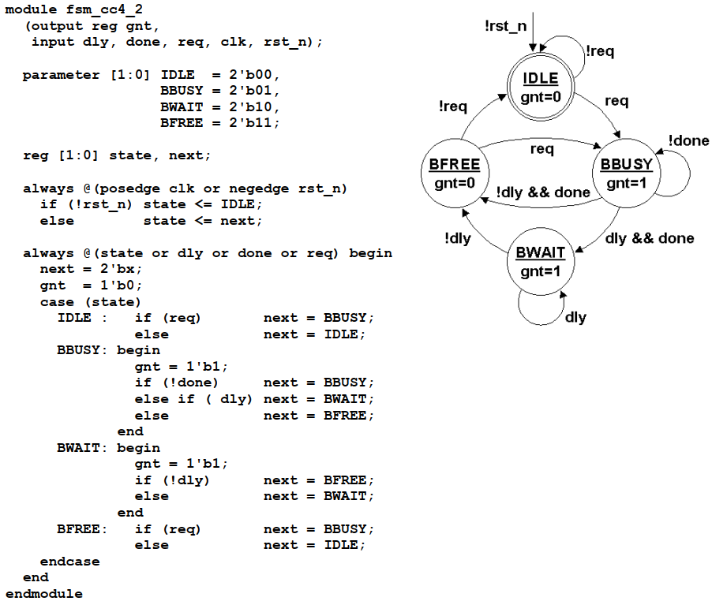
FSM Good Style: two always block
注意：在状态机中产生nextstate默认值，
1）nextstate= ‘bx；
2）nextstate=IDLE；
3）nextstate= current_state ;
方法1）方便debug状态机！

Slide 17
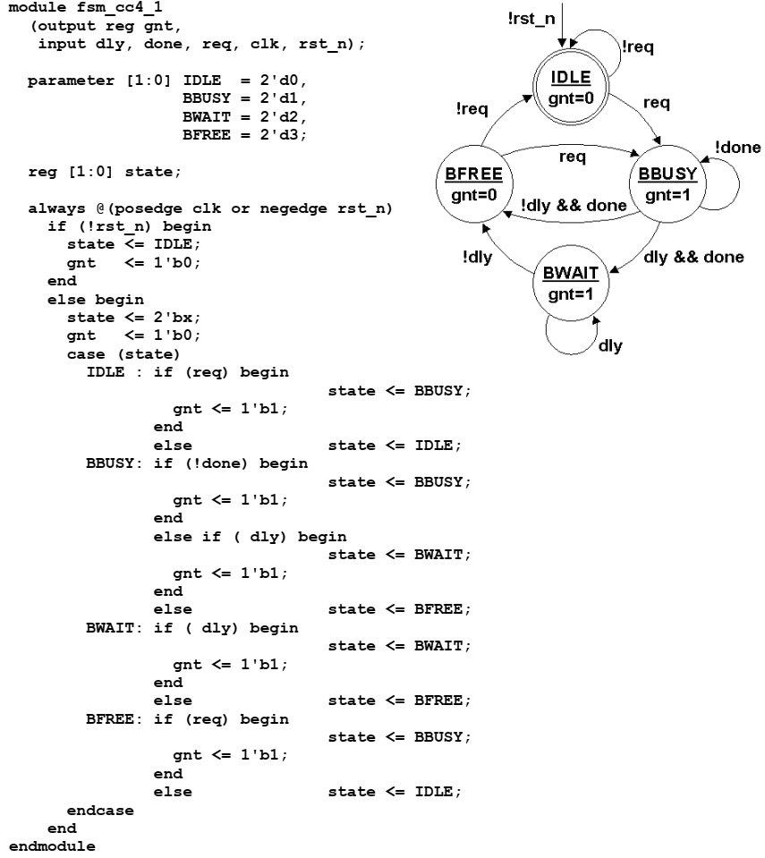
FSM Style: one always block(avoid)
注意：the one always block FSM coding style is more confusing and more error prone than a comparable two always block coding
style.
方法1）方便debug状态机！

Slide 18
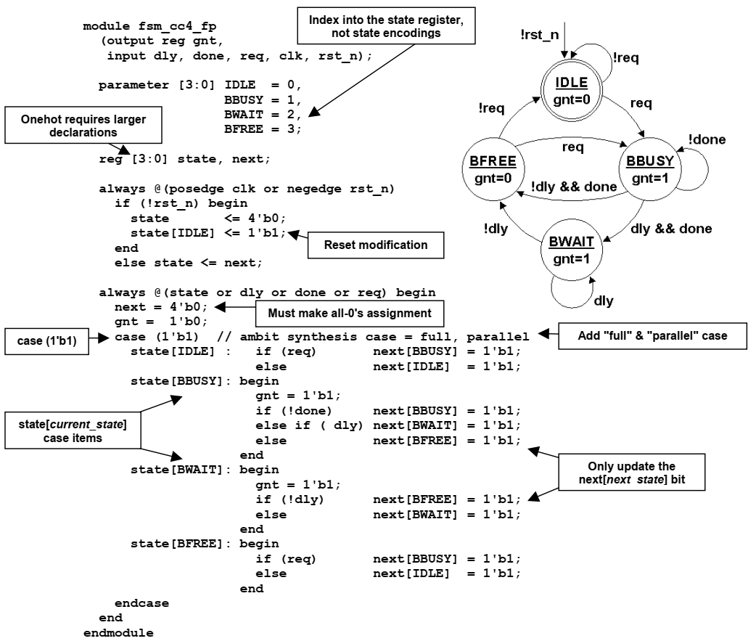
FSM Style: one-hot coding（good）

Slide 19
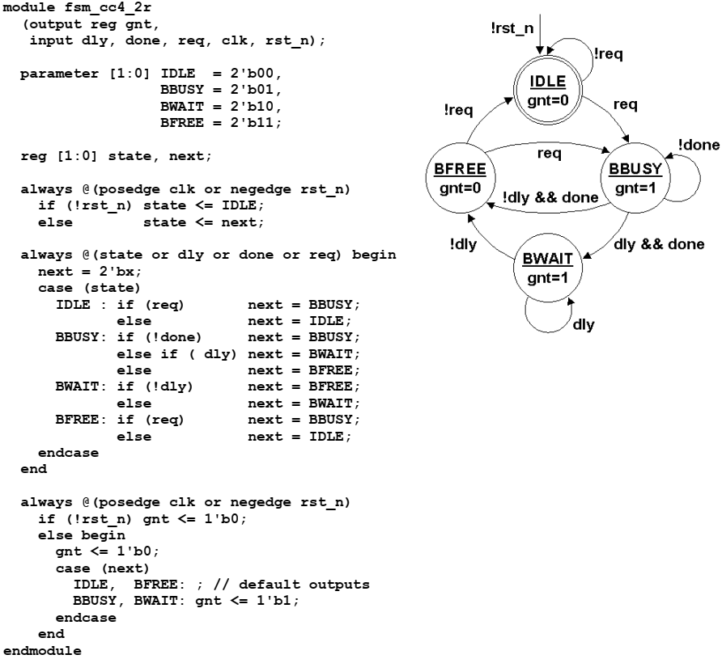
FSM Style: registered outputs(good)

Slide 20
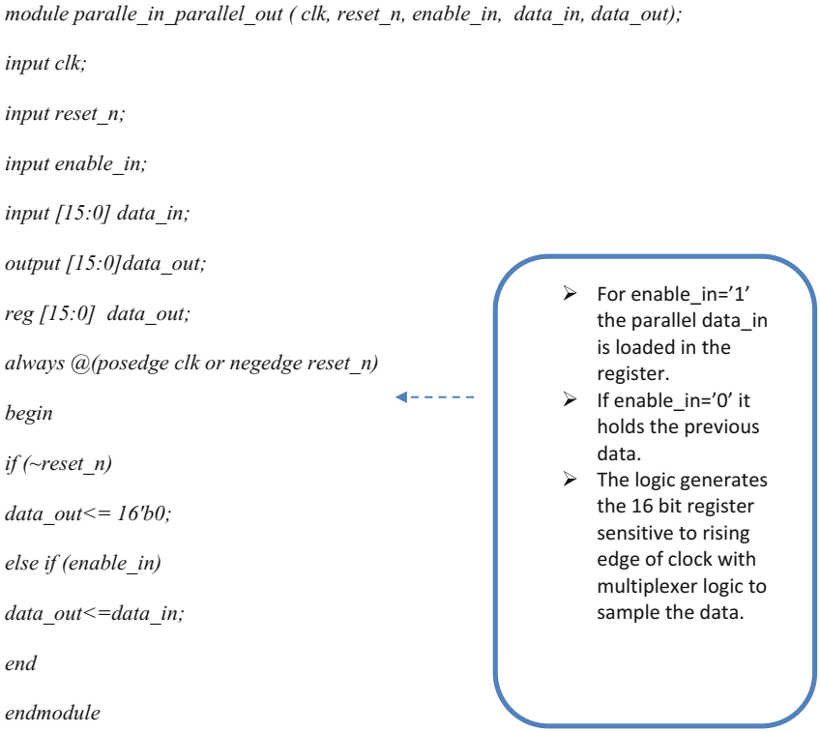
Misc. Verilog 实例：并行输入/输出

Slide 21
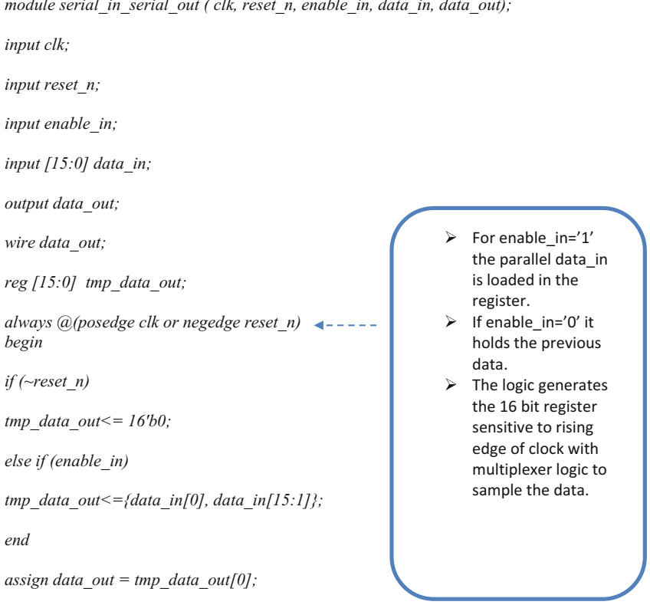
Misc. Verilog 实例：串行输入/输出
课堂练习：
1）串行输入，并行输出
2）并行输入，串行输出

Slide 22
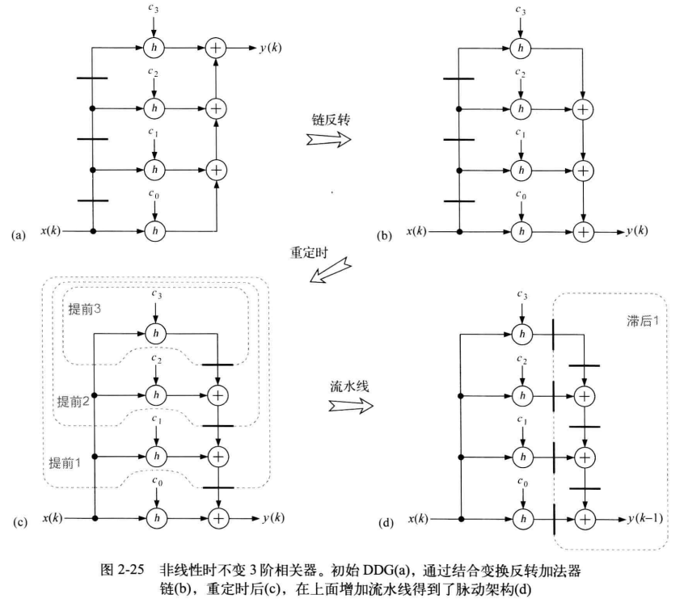
Misc. Verilog 实例：FIR
P96 （3）再考虑图2-25（a）中的三阶相关器，用Verilog实现其功能。

Slide 23
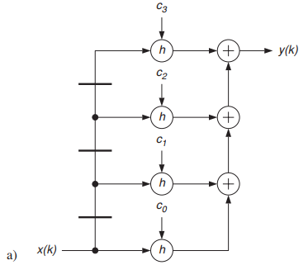
Misc. Verilog 实例：FIR(cont)
module fir_a(input clk,rstn,
input [7:0] c0, c1, c2, c3, x_in,
output reg [15:0] y_out);
reg [7:0] x1,x2,x3;
always@(posedge clk or negedge rstn)
if(~rstn) begin
{x3 , x2 , x1} <= {3{8’d0}};
end else begin
{x3 , x2 , x1} <= {x2, x1, x_in};
end
always@(posedge clk or negedge rstn)
if(~rstn) begin
y_out <= 16'd0;
end else begin
y_out <= c0 * x_in + c1 * x1 + c2 * c2 + c3 * x3;
end
endmodule

Slide 24
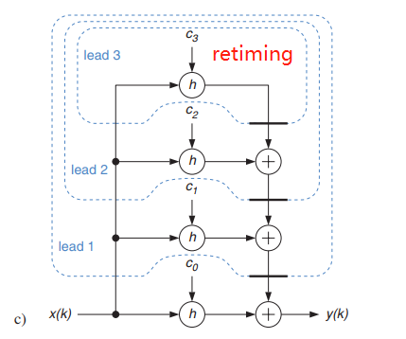
Misc. Verilog 实例：FIR(cont)
module fir_c_retiming(input clk,rstn,
input [7:0] c0, c1, c2, c3, x_in,
output reg [15:0] y_out);
reg [15:0] x1c,x2c,x3c;
always@(posedge clk or negedge rstn)
if(~rstn) begin
{x3c , x2c , x1c} <= {3{16’d0}};
end else begin
x1c <= x_in * c3;
x2c <= x_in * c2 + x1c;
x3c <= x_in * c1 + x2c;
end
always@(posedge clk or negedge rstn)
if(~rstn) begin
y_out <= 16'd0;
end else begin
y_out <= c0 * x_in + x3c;
end
endmodule

Slide 25
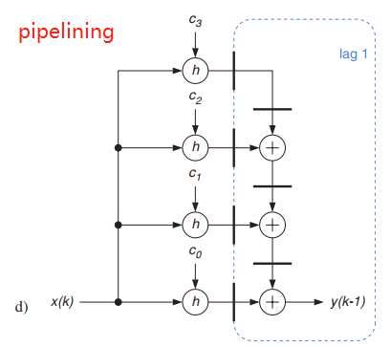
Misc. Verilog 实例：FIR(cont)
module fir_d_pipelining(input clk,rstn,
input [7:0] c0, c1, c2, c3, x_in,
output reg [15:0] y_out);
reg [15:0] x0c,x1c,x2c,x3c;
reg [15:0] x1c1,x2c1,x3c1;
always@(posedge clk or negedge rstn)
if(~rstn) begin
{x3c , x2c , x1c, x0c } <= {4{16’d0}};
{x3c1,x2c1,x1c1} <= {3{16’d0}};
y_out <= 16'd0;
end else begin
x0c <=x_in * c0;
x1c <=x_in * c1;
x2c <=x_in * c2;
x3c <=x_in * c3;
x3c1<=x3c;
x2c1<=x2c + x3c1;
x1c1<=x1c + x2c1;
y_out<=x0c + x1c1;
end
endmodule

Slide 26
Generic SRAM model
module sram_model #(parameter DW = 32, BW=4, AW = 8, DEPTH = 256)(
input clk,
Input csn,
input [AW-1:0] adr,
input [BW-1:0] wen,
input [DW-1:0] din,
output[DW-1:0] dout); // Generic single-port synchronous RAM model
reg [DW-1:0] mem [DEPTH-1:0]; // RAM content
reg [AW-1:0] addr_reg; // RAM address register
integer i;
assign dout = mem[addr_reg];
always @(posedge clk)
if (~csn) addr_reg <= adr;
always @(posedge clk)
if (~csn) begin
for (i=0;i<BW;i=i+1)
if(~wen[i]) mem[adr][i*8+：8] <= din[i*8+：8];
end
endmodule

